Slide 1
Compiler Construction
Muhammad Ismail / Faryal Shamsi
Lecturer Computer Science
Sukkur IBA University

Slide 2
Study Resources
Text Book
Aho, A. V., Sethi, R., & Ullman, J. D. (2007). Compilers: principles, techniques, and tools (Vol. 2). Reading: Addison-wesley. – the Dragon Book
Lewis, P. M., Stearns, R. E., & Rosenkrantz, D. J. (1976). Compiler design theory.

Slide 3
Study Resources
Reference Book:
Cooper, K., & Torczon, L. (2011). Engineering a compiler. Elsevier.
Louden, K. C. (1997). Compiler construction. Cengage Learning.
Wirth, N., Wirth, N., Wirth, N., Informaticien, S., & Wirth, N. (1996). Compiler construction (Vol. 1). Reading: Addison-Wesley.

Slide 4
Program Learning Outcomes (PLOs) with respect to COMPILER CONSTRUTION
GA1 Computing Knowledge: An ability to apply knowledge of mathematics, science, computing fundamentals and computing specialization to the solution of complex computing problems.
GA2 Problem Analysis: An ability to identify, formulate, research literature, and analyze complex computing problems reaching substantiated conclusions using first principles of mathematics, natural sciences and computing sciences.
GA3 Design/Development of Solutions: An ability to design solutions for complex computing problems and design systems, components or processes that meet specified needs with appropriate consideration for public health and safety, cultural, societal, and environmental considerations.

Slide 5
Course Learning Outcomes
To understand how compilers translate source code to machine executable.
Identify tokens of a typical high-level programming language
To comprehend how to perform parsing.
To apply parsing algorithms for syntax analysis.
To understand how compilers generate machine code.
To be familiar with techniques for simple code optimizations.

Slide 6
Assessment Strategy – Negotiable!!!
Tool Name | Weightage | Criteria
Mid Examination | 30 Points | Correctness of Solutions, Ethics
Final Examination | 50 Points | Correctness of Solutions, Ethics
Project Presentation/ Demonstration | 10 Points | Submission Punctuality, Class Participation
Assignments | 10 Points | Submission Punctuality, Ethics

Slide 7
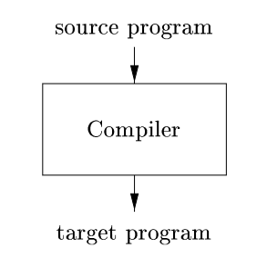
What are compilers?

Slide 8
What are compilers?
A translator or a language processor
  Compiler
  Interpreter
  Assembler

Slide 9
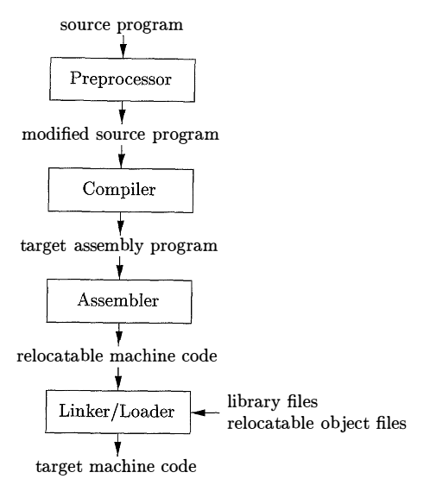
Language Processing System

Slide 10
Pre-processor

Slide 11
Pre-processor
A program that processes the source code before it is compiled by the compiler.
#define: This statement is used to define a macro, which is essentially a symbolic name for a value or a piece of code. For example:
  #define PI 3.1415
#include: This statement is used to include a header file in the source code. For example:
  #include <stdio.h>

Slide 12
Pre-processor
The preprocessor permits conditionally compiling portions of code based on certain conditions using directives like #ifdef, #ifndef, #if, #else, and #endif.
  #ifdef ENABLE_LOGGING
  System.out.println("Logging is enabled");
  #endif
To enable or disable the preprocessing, set the preprocess.enabled property in your Maven project configuration.
  <properties>
  <preprocess.enabled>true</preprocess.enabled>
  </properties>

Slide 13
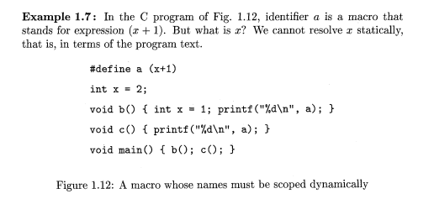
Role of Preprocessor Directive

Slide 14
Java Pre-processor
There is no preprocessor directive in Java. Unlike languages like C and C++, Java does not have a preprocessor that can modify the source code before it is compiled.
Java instead relies on the runtime environment to handle things like platform-specific code inclusion and conditional compilation.

Slide 15
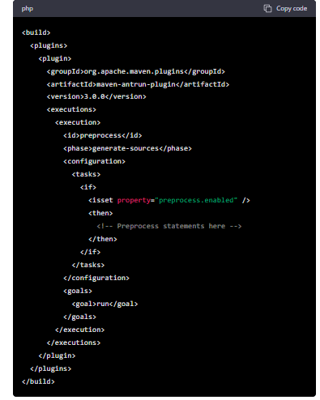
Java Pre-processor
Add the maven-antrun-plugin plugin to your Maven project's pom.xml file.
This plugin allows you to execute Ant tasks within your Maven build.

Slide 16
Linker / Loader

Slide 17
Linker / Loader
Linker is a computer program that links and merges various object files together in order to make an executable file. All these files might have been compiled by separate assemblers. The major task of a linker is to search and locate referenced module/routines in a program and to determine the memory location where these codes will be loaded, making the program instruction to have absolute references.

Slide 18
Linker / Loader
Loader is a part of operating system and is responsible for loading executable files into memory and execute them. It calculates the size of a program (instructions and data) and creates memory space for it. It initializes various registers to initiate execution.

Slide 19
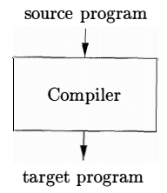
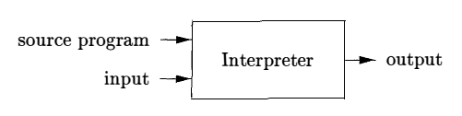
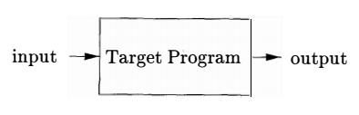
Compiler vs Interpreter
Compiler
Interpreter

Slide 20
Compiler vs Interpreter
Compiler
Interpreter
A language rewriter program that translates the form of expressions without a change of meaning.
C, C++
An execution program that directly runs instructions, without requiring them previously to have been compiled into a machine language program.
HTML, Lisp, Pearl

Slide 21
How Java works?
What about Python?
What are these?
  Bytecode?
  Virtual Machine?

Slide 22
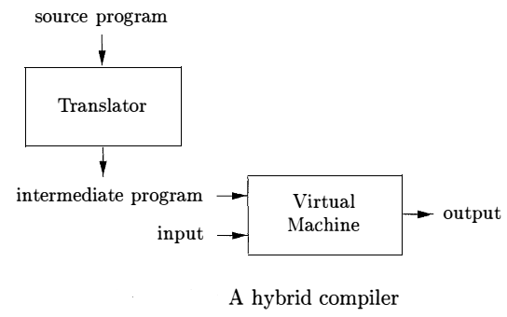
Hybrid Complier

Slide 23
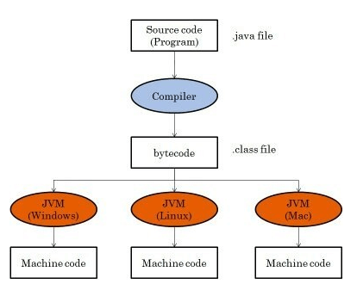
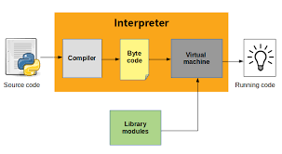


Intermediate Code – Bytecode
Java
Python
Statically typed, compiled language
Dynamically typed, (Scripting) non-compiled language

Slide 24
Phases of Compiler
Analysis / Front-end
Synthesis / Back-end
Machine Independent Optimization (optional)

Slide 25
Frontend – Analysis
If the analysis part detects that the source program is either syntactically ill formed or semantically unsound, then it must provide informative messages, so the user can take corrective action.
The analysis part also collects information about the source program and stores it in a data structure called a symbol table which is passed along with the intermediate representation to the synthesis part .

Slide 26
Backend – Synthesis
The synthesis part constructs the desired target program from the intermediate representation and the information in the symbol table.
The symbol table, which stores information about the entire source program, is used by all phases of the compiler.

Slide 27
Mid-end or Optimization
Some compilers have a machine-independent optimization phase between the front end and the back end
The purpose of this optimization phase is to perform transformations on the intermediate representation, so that the back-end can produce a better target program than an un-optimized intermediate representation

Slide 28
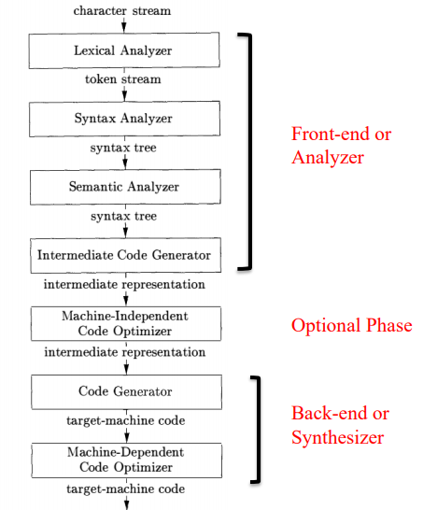
The Structure of a Compiler
Symbol Table

Slide 29
Modern compilers contain two (large) parts, each of which is often subdivided.
These two parts are the –
  front-end(analyzer), and the
  back-end (synthesizer)
The analysis part breaks up the source program into –
  constituent pieces and
  Imposes a grammatical structure on them
It then uses this structure to create an intermediate representation (IR) of the source program.

Slide 30
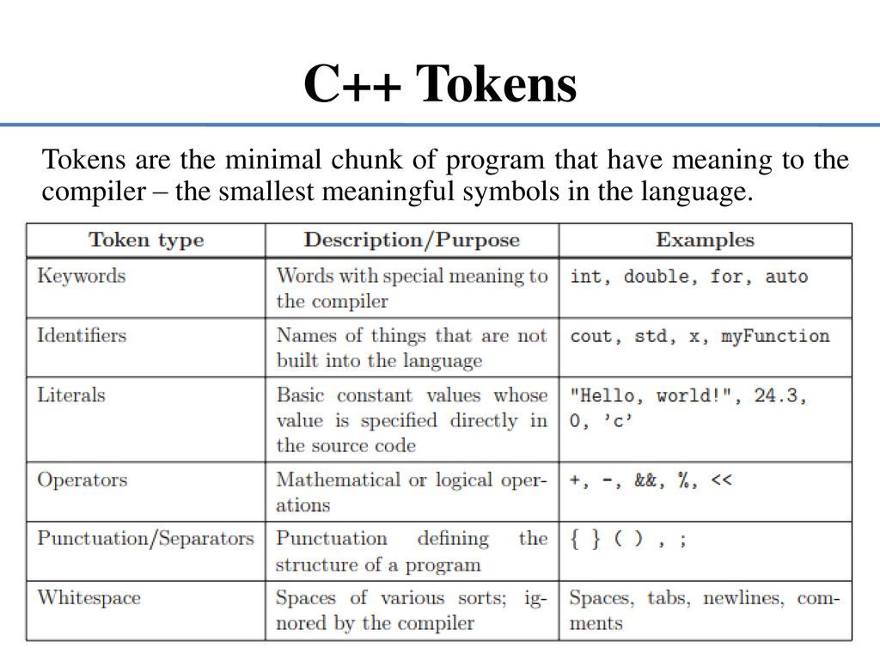

Slide 31

Lexical Analysis
For example,
position = initial + rate * 60
Lexemes (position,=,initial,+,rate,*,60) are mapped into following tokens –
Position is a lexeme that would be mapped into a token <id , 1> where id is an abstract symbol standing for identifier and 1 points to the symbol table entry for position.
The assignment symbol = is a lexeme that is mapped into the token <=>. It does not need attribute value to store name and type.
Blanks separating the lexemes would be discarded by the lexical analyzer.

Slide 32
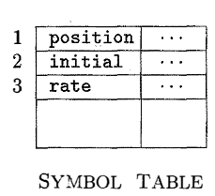
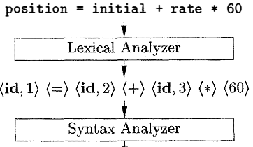
Lexical Analysis
The symbol-table entry for an identifier holds information about the identifier, such as its name and type.

Slide 33
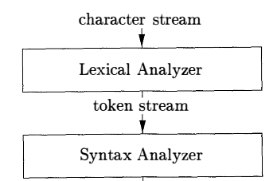
Lexical Analysis/ Scanning

Slide 34
Lexical Analysis/ Scanning
Reads the stream of characters making up
the source program and groups the characters
into meaningful sequences called lexemes.
For each lexeme, the lexical analyzer produces as output a token of the form
<token-name , attribute-value>
token-name is an abstract symbol that is used during syntax analysis,
attribute-value points to an entry in the symbol table for this token.

Slide 35
Syntax Analysis or Parsing
The syntax Analyzer (parser) uses the first components of the tokens produced by the lexical analyzer to create a tree-like intermediate representation(IR = transition state) that depicts the grammatical structure of the token stream.
A typical representation is a syntax tree in which each interior node represents an operation and the children of the node represent the arguments of the operation.

Slide 36
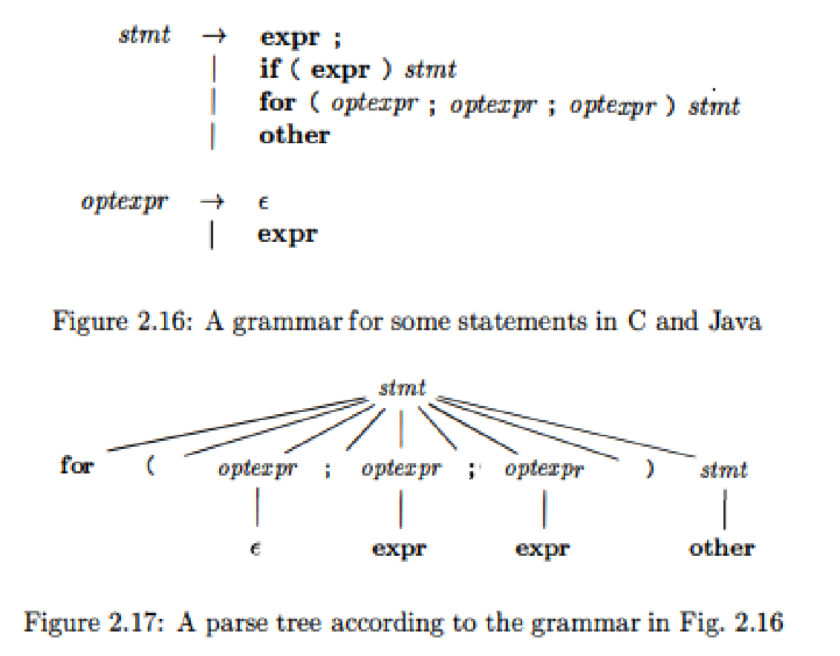
Input: for ( ; expr ; expr )

Slide 37
Parser / Parsing???
Context-free grammars will be used to specify the grammatical structure of programming languages and discuss algorithms for constructing efficient syntax analyzers/parser automatically from certain classes of grammars.

Slide 38
Parsing id+id*id E → E+E |E*E | id
E
E
E
E
E
E
+
*
E
E
E
E
id
id
*
+
id
id
id
id

Slide 39
Semantic Analyzer
An important part of semantic analysis is type checking, where the compiler checks that each operator has matching operands.
The compiler needs semantic information, e.g., the types (integer, real, pointer to array of integers, etc.) of the objects involved.
The language specification may permit some type conversions called coercions.
Suppose that position, initial, and rate have been declared to be floating-point numbers, and that the lexeme 60 by itself forms an integer. Here integer may be converted into floating-point.

Slide 40
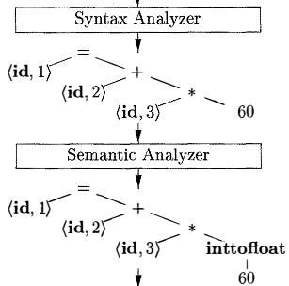
Semantic Analysis

Slide 41
Intermediate Code Generation
After syntax and semantic analysis of the source program, many compilers generate an explicit low-level or machine-like intermediate representation,
This intermediate representation (IR) should have two important properties:
  it should be easy to produce and
  it should be easy to translate into the target machine.

Slide 42
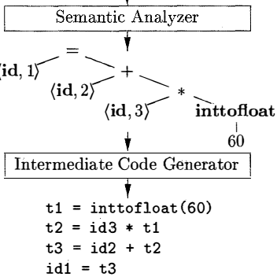
Intermediate Code Generation

Slide 43
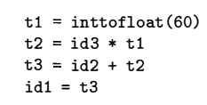
The 3-address Code
we consider an intermediate form called three-address code,
which consists of a sequence of assembly-like instructions with three operands per instruction.
Each operand can act like a register .

Slide 44
The 3-address Code
There are several points worth noting about three-address instructions.
First , each three-address assignment instruction has at most one operator on the right side. Thus, these instructions fix the order in which operations are to be done; the multiplication precedes the addition in the source program.
Second, the compiler must generate a temporary name to hold the value computed by a three-address instruction.
Third, some "three-address instructions" like the first and last in the sequence above, have fewer than three operands.

Slide 45
Code Optimization
The machine-independent code optimization phase attempts to improve the intermediate code so that better target code will result .
Usually better code means faster, shorter, or target code that consumes less power

Slide 46

Code Optimization

Slide 47
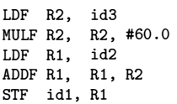
Code Generation
The code generator takes as input an intermediate representation of the source program and maps it into the target language.
If the target language is machine code, registers or memory locations are selected for each of the variables used by the program.
Then, the intermediate instructions are translated into sequences of machine instructions that perform the same task.
The F in each instruction tells us that it deals with floating-point numbers
The # signifies that 60.0 is to be treated as an immediate constant.

Slide 48
Types of a Compiler
Single-pass compilers
2-pass compilers
Multi-pass compilers

Slide 49
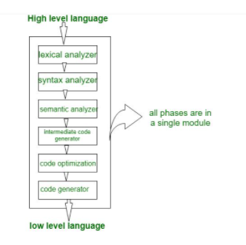
Single Pass Compiler
If we combine or group all the phases of compiler design in a single module known as single pass compiler.

Slide 50
Single Pass Compiler
A one pass/single pass compiler is that type of compiler that passes through the part of each compilation unit exactly once.
Single pass compiler is faster and smaller than the multi pass compiler.
As a disadvantage of single pass compiler is that it is less efficient in comparison with multi-pass compiler.
Single pass compiler almost never done, early Pascal compiler did this as an introduction.

Slide 51
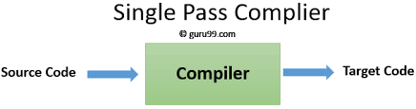
We can not optimize very well due to the context of expressions are limited, as we can’t backup and process, it again so grammar should be limited or simplified.

Slide 52
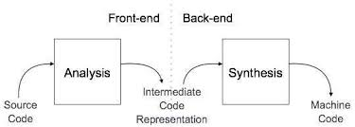
2-pass or Multi-pass Compiler
A Two pass/multi-pass Compiler is a type of compiler that processes the source code or abstract syntax tree of a program more than once. In multi-pass Compiler we divide phases in two pass as:

Slide 53
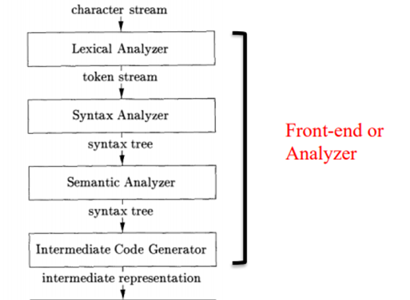
First Pass
(a). Front end
(b). Analytic part
(c). Platform independent

Slide 54
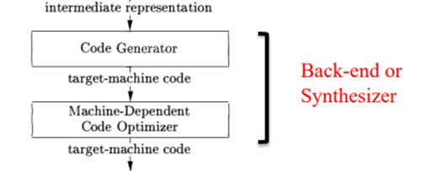
Second Pass
(a). Back end
(b). Synthesis Part
(c). Platform Dependent

Slide 55
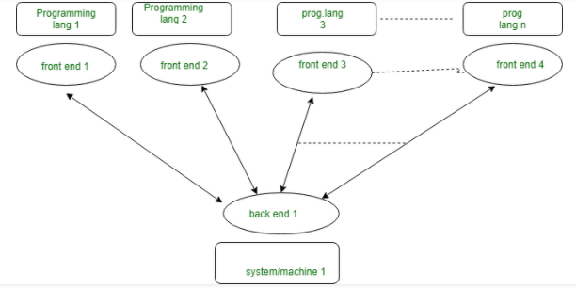
Multi-pass Benefit – 1

Slide 56
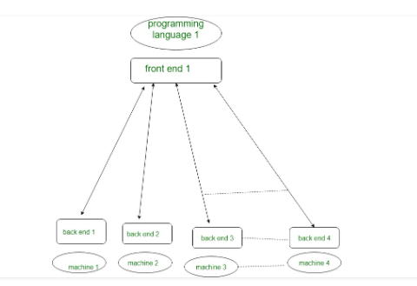
Multi-pass Benefit – 2

Slide 57
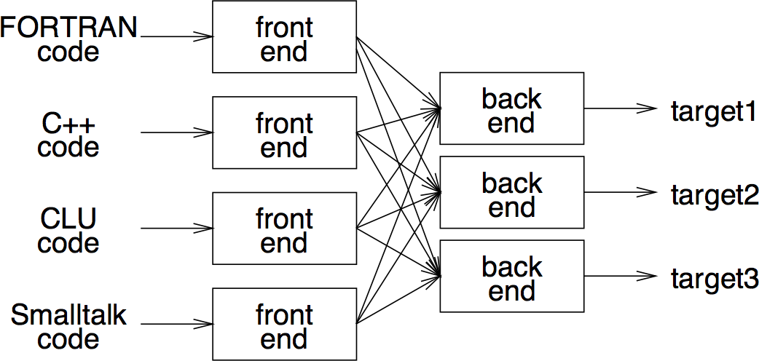
An ideal Multi-pass Compiler

Slide 58
The Cross Compilers
A cross compiler is one that can run on a computer’s operating system that is different from the operating system that the program ordinarily uses. It breaks down binary codes, understands them and allows computer programmers to gain access to the codes.
For example, a compiler that runs on a Windows 7 PC but generates code that runs on Android smartphone is a cross compiler.

Slide 59
Parallelizing Compiler
A parallelizing compiler is typically a compiler that finds parallelism in a sequential program and generates appropriate code for a parallel computer.
More recent parallelizing compilers accept explicitly parallel language constructs, such as array assignments or parallel loops.
Applications: Big Data and Multithreading

Slide 60
Compiler Traditional Application
Implementation of High-Level Programming Languages
Optimizations for Computer Architectures
  Parallelism, parallel (independent) or serial(dependent) instruction be executed
  memory hierarchy (register, cache, RAM,HDD)
Design of New Computer Architectures
  CISC -Complex Instruction set computer, used in x86 machines
    Uses complex addressing to store data structures using registers and stack.
  RISC-Reduced Instruction set computer
    PowerPC, SPARC , MIPS, Alpha, and PA-RIS C, are based on the RISC concept
  Specialized Architectures (embedded machines)

Slide 61
Compiler Also……
Natural Language Processing
Database Query Interpreters
Compiled Simulation
  Instead of writing a simulator that interprets the design, it is faster to compile the design to produce machine code that simulates that particular design natively.
Hardware Synthesis:
  Hardware designs are typically described at the register transfer level (RTL) , where variables represent registers and expressions represent combinational logic.
  Hardware-synthesis tools translate RTL descriptions automatically into gates , which are then mapped to transistors and eventually to a physical layout .

Slide 62
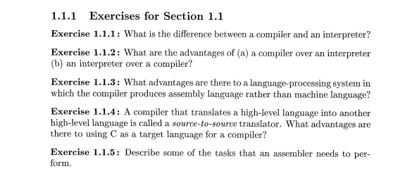
Assignment 1

Slide 63
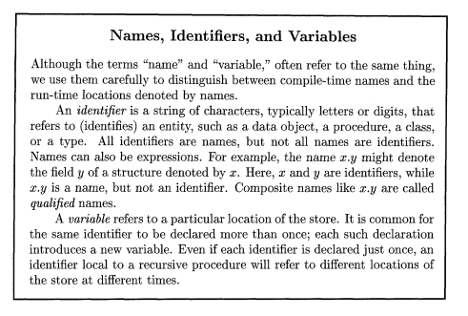
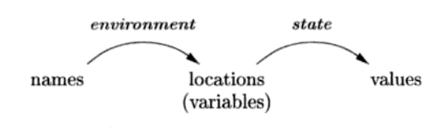
Programming Language Basics

Slide 64
Programming Language Basics
Environment and states (Figure 1.8)
Environment is mapping from names to location
State is mapping from location value

Slide 65
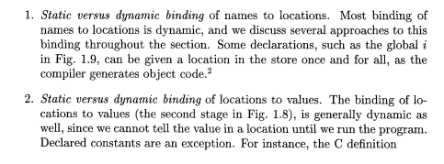
Programming Language Basics

Slide 66
Intermediate Code – Bytecode
Java
Python
Statically typed, compiled language
Dynamically typed, (Scripting) non-compiled language

Slide 67
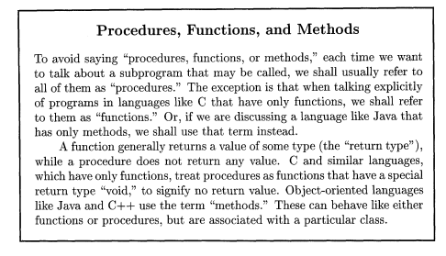
Programming Language Basics

Slide 68
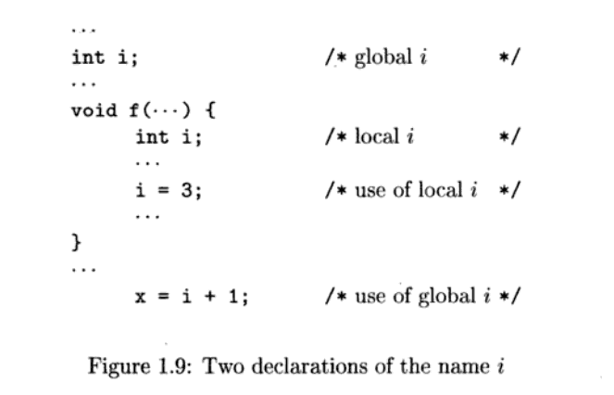
Programming Language Basics

Slide 69
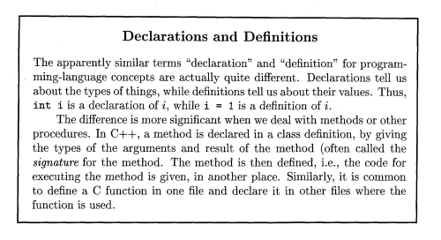
Scopes and Declarations

Slide 70
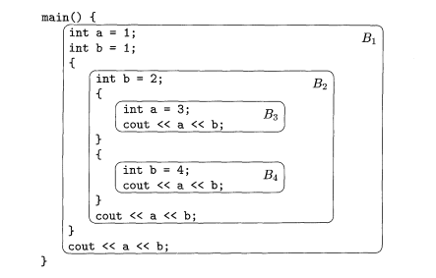
Scopes and Declarations

Slide 71
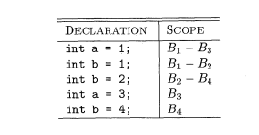
Scopes and Declarations

Slide 72
Scopes and Declarations

Slide 73
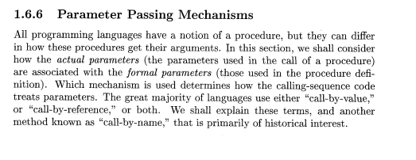

Slide 74
Call by Value
In call-by-value, the actual parameter is evaluated (if it is an expression) or copied (if it is a variable).
The value is placed in the location belonging to the corresponding formal parameter of the called procedure.
This method is used in C and Java, and is a common option in C++, as well as in most other languages.
Call-by-value has the effect that all computation involving the formal parameters done by the called procedure is local to that procedure, and the actual parameters themselves cannot be changed.

Slide 75
Call by Reference
In call- by-reference, the address of the actual parameter is passed to the callee as the value of the corresponding formal parameter.
Uses of the formal parameter in the code of the callee are implemented by following this pointer to the location indicated by the caller. Changes to the formal parameter thus appear as changes to the actual parameter.
If the actual parameter is an expression, however, then the expression is evaluated before the call, and its value stored in a location of its own. Changes to the formal parameter change this location, but can have no effect on the data of the caller.

Slide 76
Call by Name
This was used in the early programming language Algol 60.
It requires that the callee execute as if the actual parameter were substituted literally for the formal parameter in the code of the callee, as if the formal parameter were a macro standing for the actual parameter (with renaming of local names in the called procedure, to keep them distinct).
When the actual parameter is an expression rather than a variable, some unintuitive behaviors occur, which is one reason this mechanism is not favored today.

Slide 77
Aliasing
There is an interesting consequence of call-by-reference parameter passing or its simulation, as in Java, where references to objects are passed by value.
It is possible that two formal parameters can refer to the same location; such variables are said to be aliases of one another.
As a result, any two variables, which may appear to take their values from two distinct formal parameters, can become aliases of each other, as well.

Slide 78
Aliasing – Example 1.9
Suppose a is an array belonging to a procedure p, and p calls another procedure q(x, y) with a call q(a, a).
Suppose also that parameters are passed by value, but that array names are really references to the location where the array is stored, as in C or similar languages.
Now, x and y have become aliases of each other. The important point is that if within q there is an assignment x [10] = 2, then the value of y[10] also becomes 2.

